Slide 1
February 8, 2024

Slide 2
Introduction
ECEA Board – Kerry Jiblits, Don Gray, Jill Adair
Non-partisan, grassroots group
2021
Save the Bijou
Expansion

Slide 3
ECEA Mission and Objectives
Protect our community by minimizing the environmental and economic degradation from Segment 5 of the Colorado Power Pathway Project (CPPP) within Elbert County
Maintain healthy lifestyles for our families
Protect wildlife
Protect our local economy
Protect the beauty of our county
Protect the historic Bijou Basin
Maintain property value
Limit the spread of big city resource requirements being built within our small county.

Slide 4
Xcel Energy’s Power Pathway

Slide 5
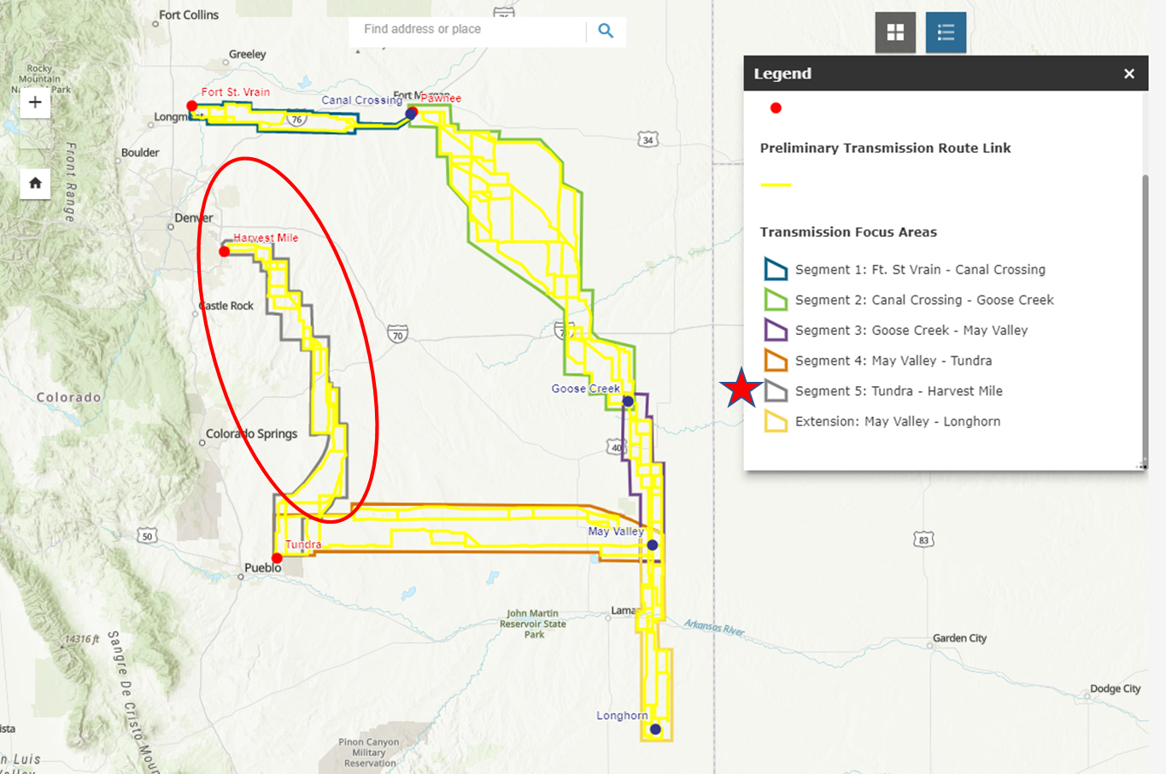
Colorado’s Pathway Project
Schedule
Current Activities: Routing and Siting Studies
Permitting: 2022-2023
Construction: 2025-2027
In-service: 2027

Slide 6
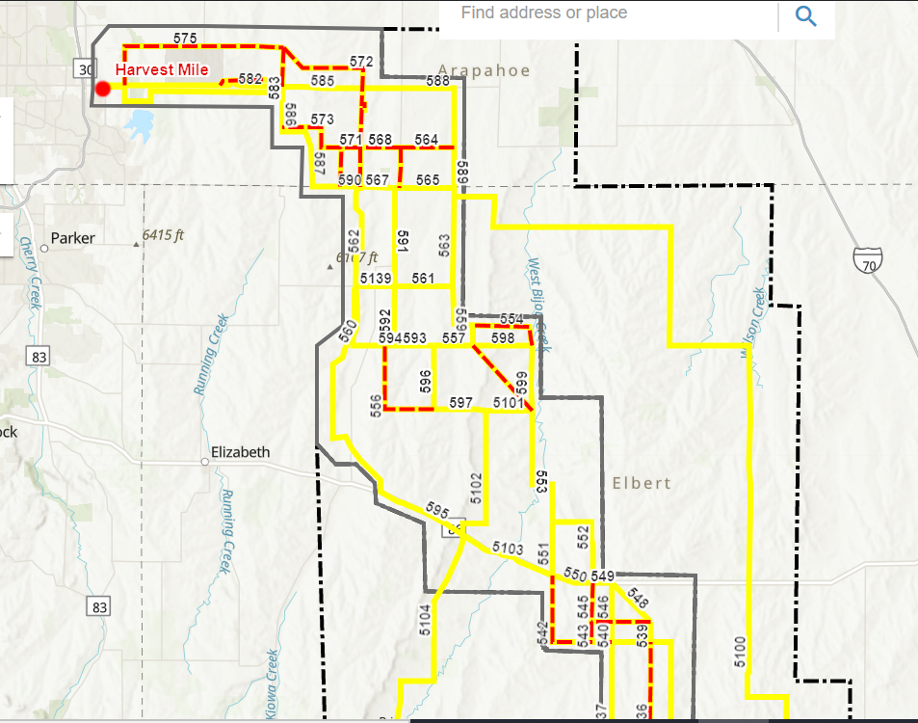
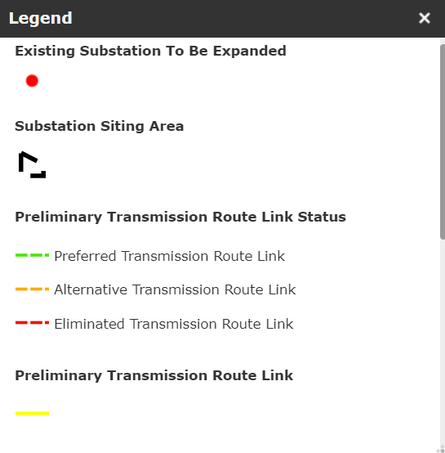
Elbert County Detail – February 2023

Slide 7
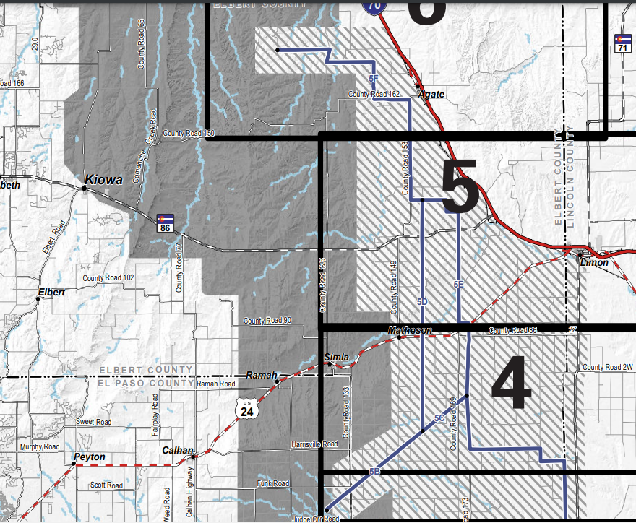
Eastern Review Area

Slide 8
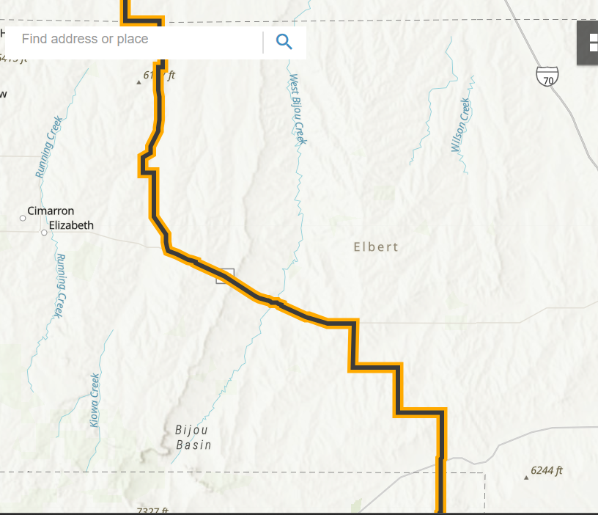
Xcel’s Preferred Route
Feb. 2024

Slide 9
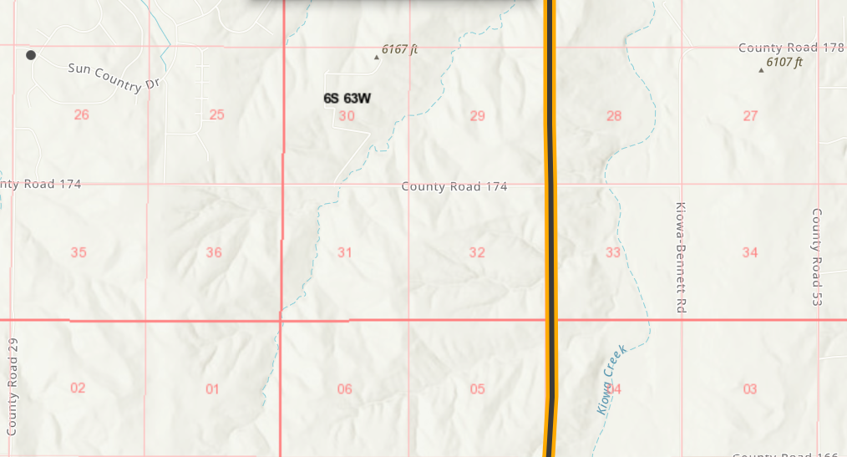
Preferred Route Close Up

Slide 10
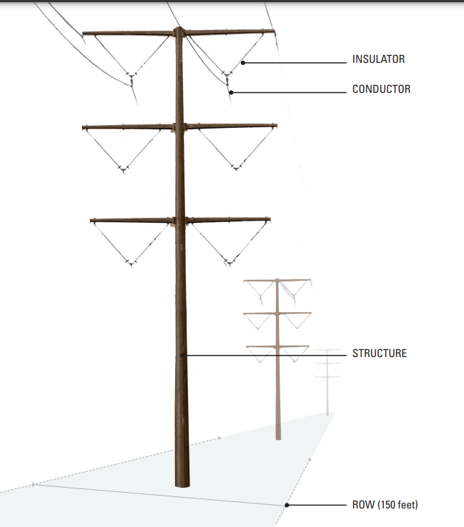
Design of lines
Cement Base
6-8 feet wide
20-40 feet deep
Right of Way
150 feet wide easements

Slide 11
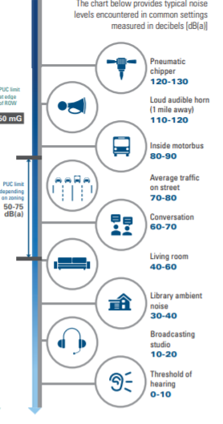
Concerns
NOISE

Slide 12
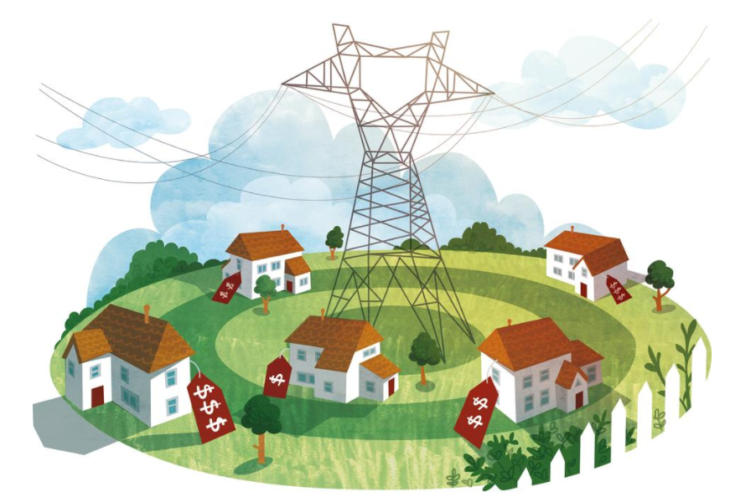
Property Values
A recent study in the Journal of Real Estate Research by Charleston assistant professors Chris Mothorpe and David Wyman, finds that vacant lots adjacent to high-voltage transmission lines sell for 45% less than equivalent lots not located near transmission lines.
Wall Street Journal; August 15, 2018

Slide 13
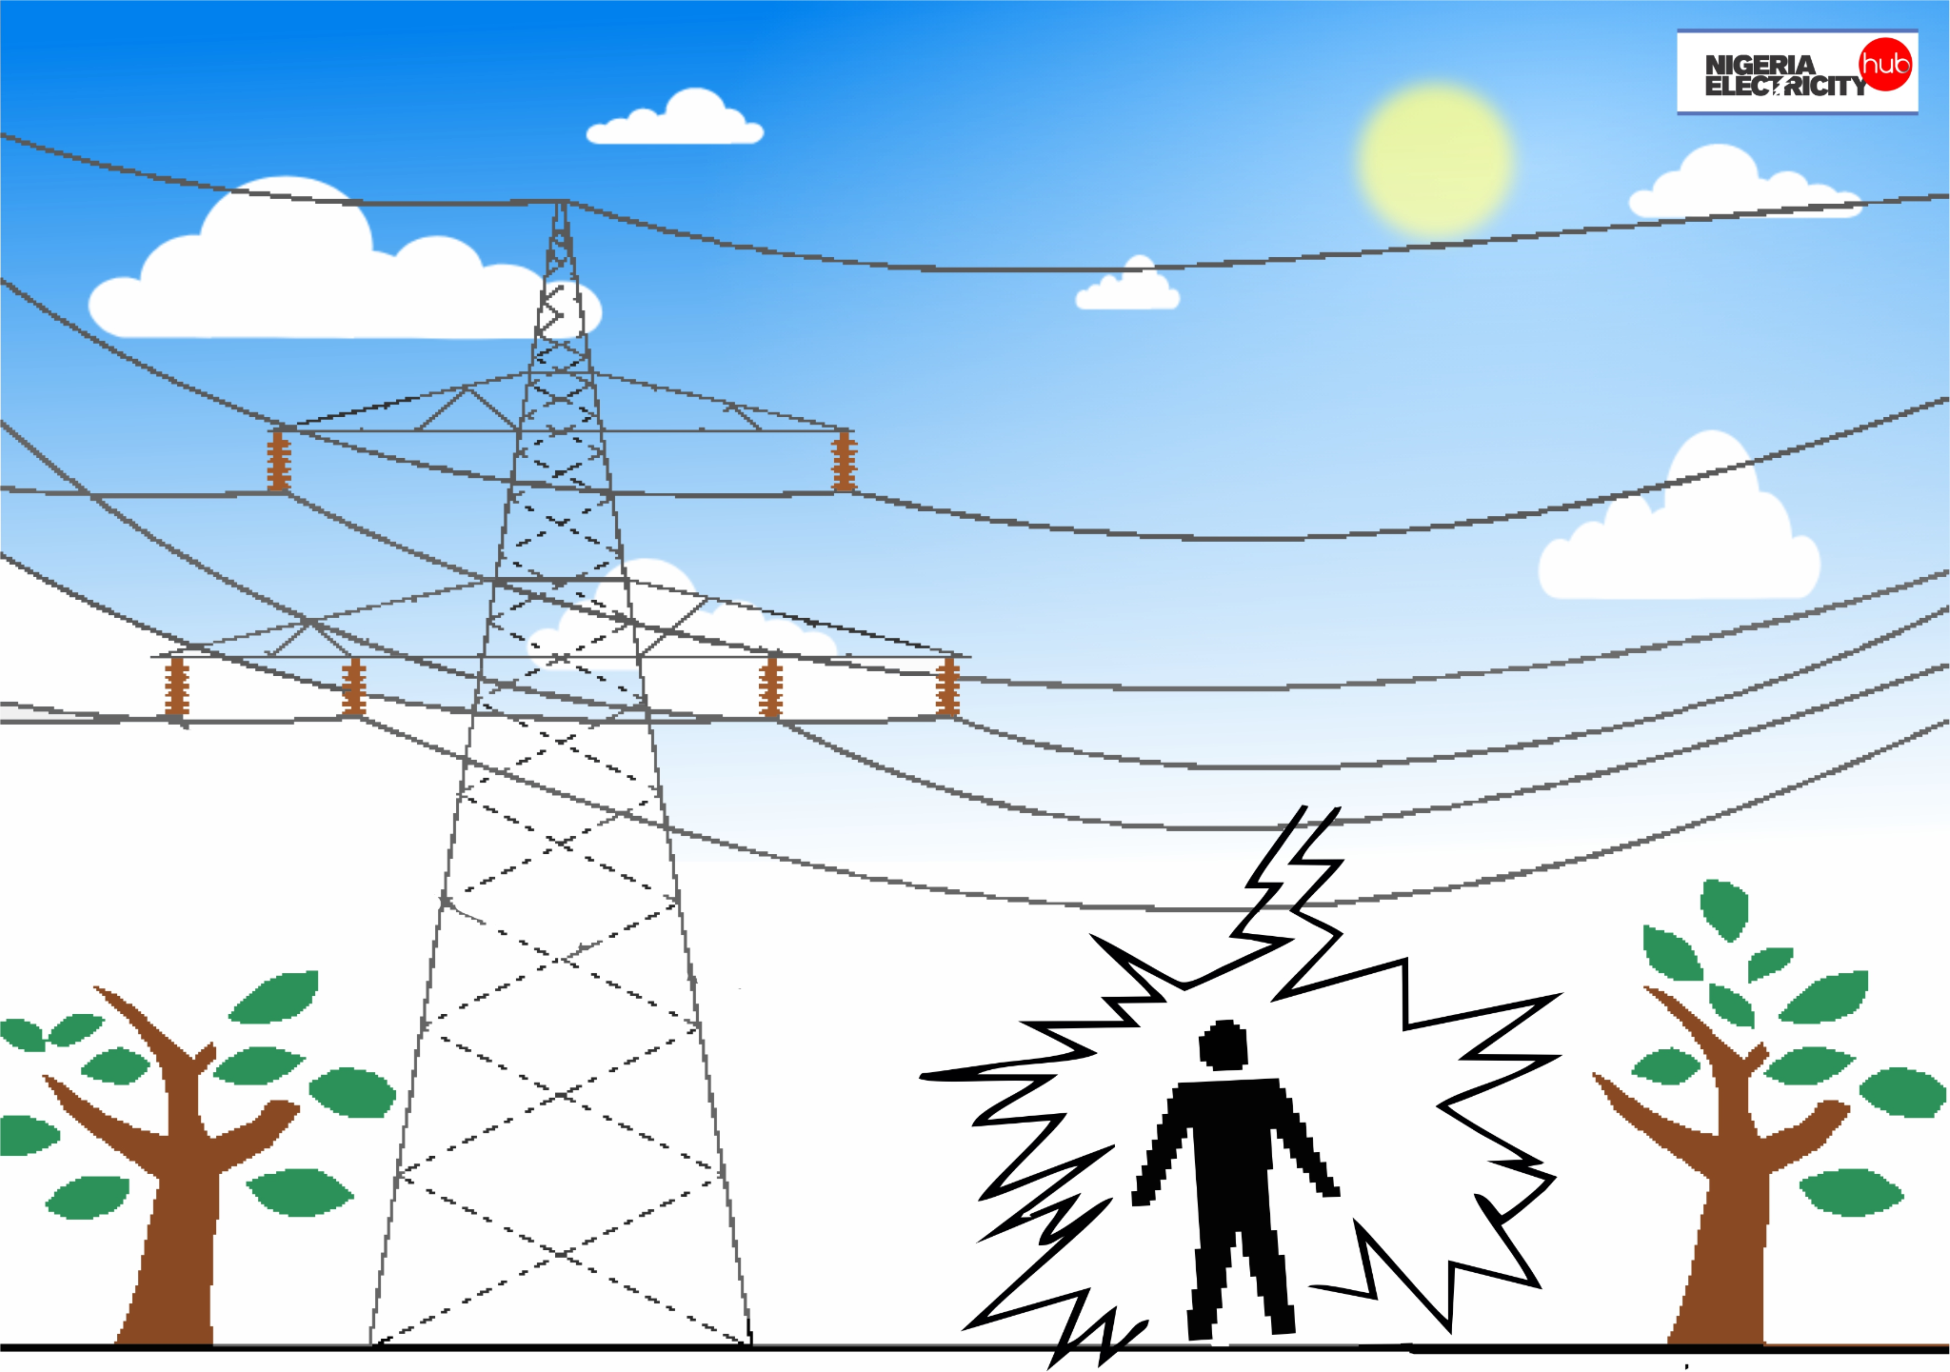
Health Concerns
Cancer
Leukemia
Depression
Headaches
Fatigue
Insomnia
… and more

Slide 14
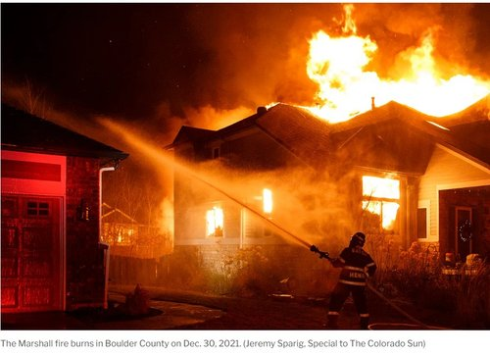
Fire
Xcel Power Line was the Cause of the Deadly Marshall Fire

Slide 15
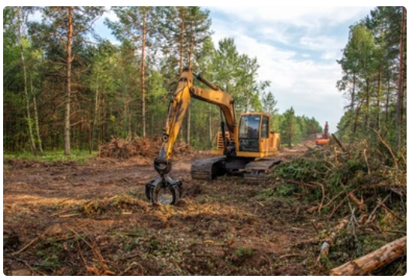
Clear cutting forests

Slide 16
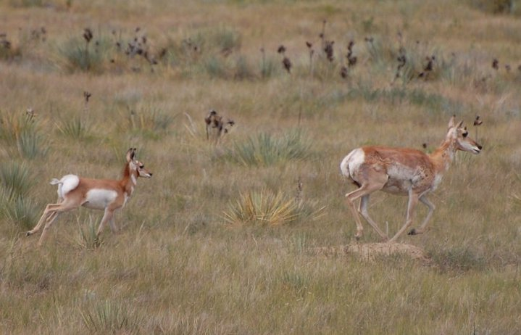
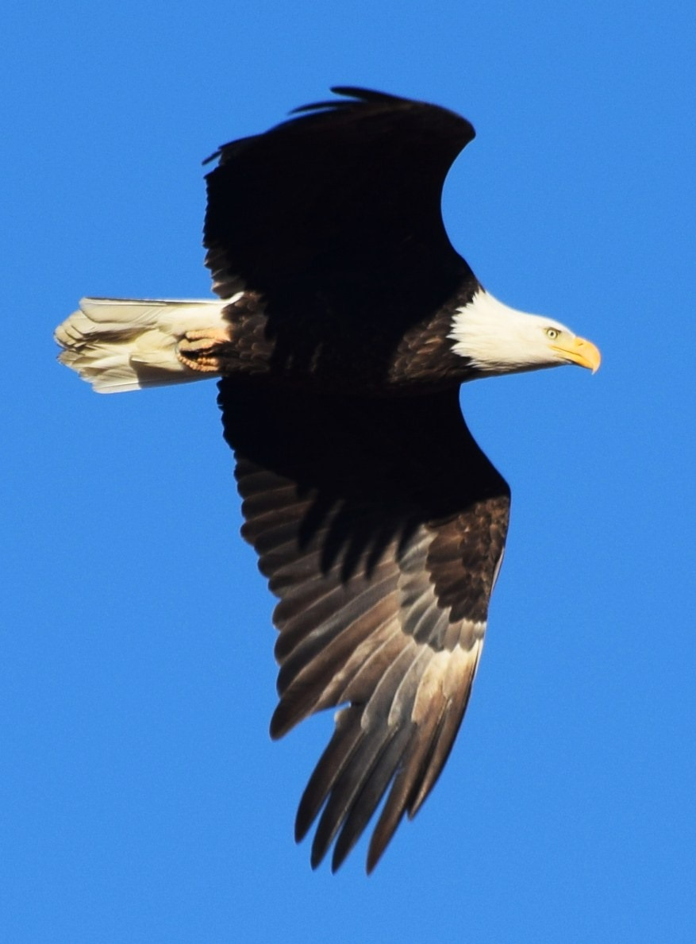
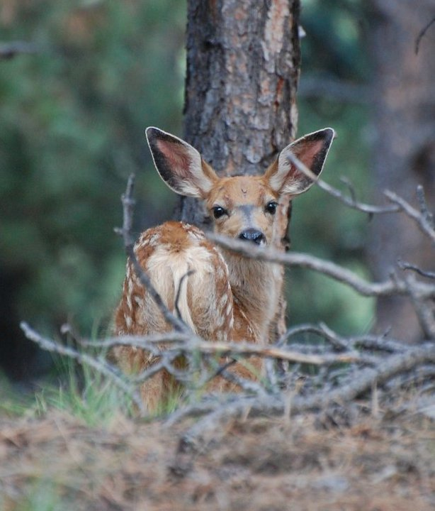
Wildlife

Slide 17
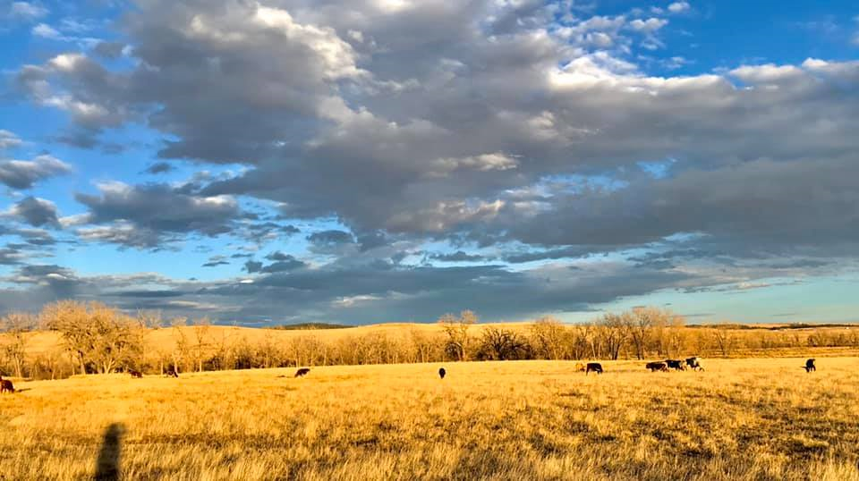
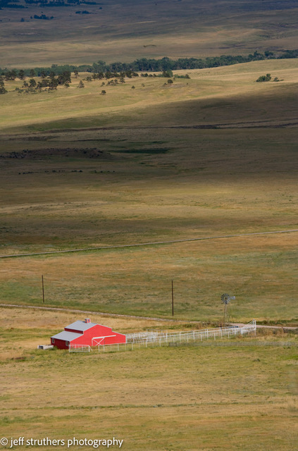
Viewshed

Slide 18
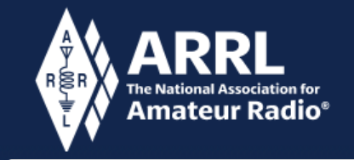
WiFi, Cell Towers, Television Transmission

Slide 19
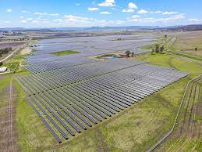
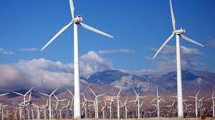
Ultimate Purpose
Wind and solar facilities will be placed within a 35 mile range of the lines

Slide 20
Who Benefits??
Metro area
Other states
Xcel’s profits
According to the May 2023 Independence Institute Report, The Future of Colorado Energy:
“…the more infrastructure a utility builds, the more profit it can earn as long as the PUC approves those investments. Under this system, utilities stand to benefit considerably from an energy transition that forces the closure of still-useful power plants and encourages a major build out of brand-new generation facilities and transmission lines. It should come as no surprise, then, that the single-largest driver of cost under both the Polis Plan and the LCD Scenario is utility profits, since both scenarios necessarily involve building a substantial amount of new electricity infrastructure over a short period of time.”

Slide 21
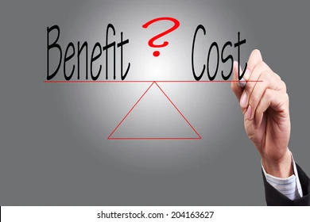
. . . and for Elbert County??
NO BENEFIT FOR ELBERT COUNTY!!!!
And with the decrease in property values, there will be a negative impact on Elbert County’s tax base, which will affect services

Slide 22
On the horizon
Probable legislation
Will override local control of land issues
Transmission corridors
Wind
Solar
1041 Regulations – “to allow for local governments to maintain their control over particular development projects even where the development project has statewide impacts.”
Contact legislators

Slide 23
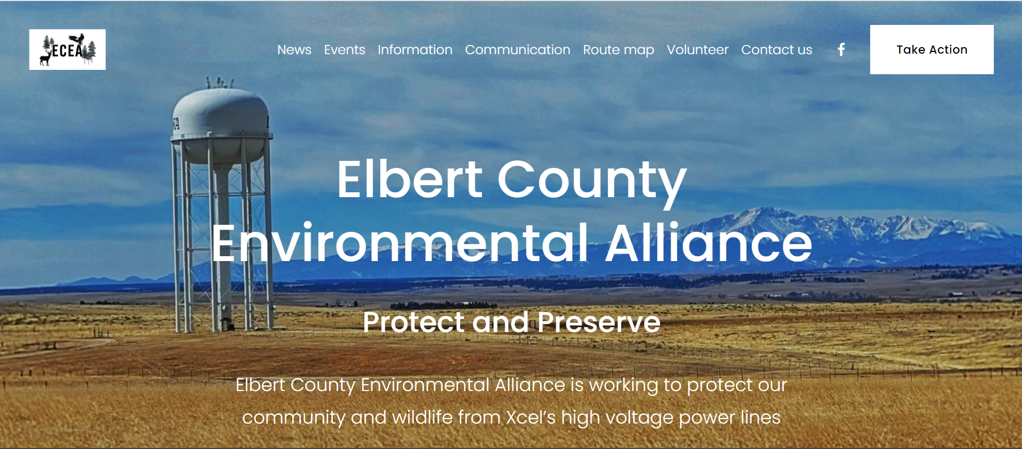
What ECEA is Doing
Community outreach
Website
Updates
Mailing list
BOCC/legislators
Media

Slide 24
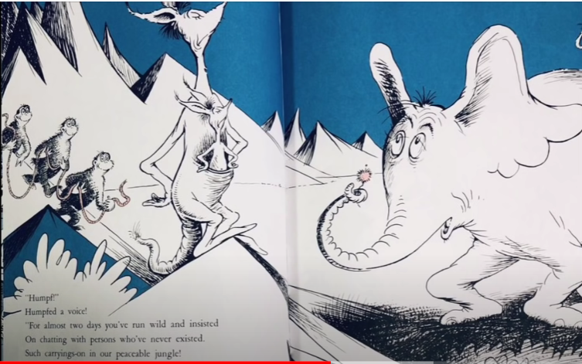
Xcel
Elbert County
Metro area

Slide 25
And he climbed with the lad up the Eiffelberg Tower.
“This”, cried the Mayor, “is your town’s darkest hour!
The time for all Whos who have blood that is red
To come to the aid of their country”, he said.
“We’ve GOT to make noises in greater amounts!
So, open your mouth, lad.
For every voice counts!”

Slide 26
We Need YOUR Voice!

